Slide 2
REFACTORING TECHNIQUES
AND RELATED TOPICS

Slide 3
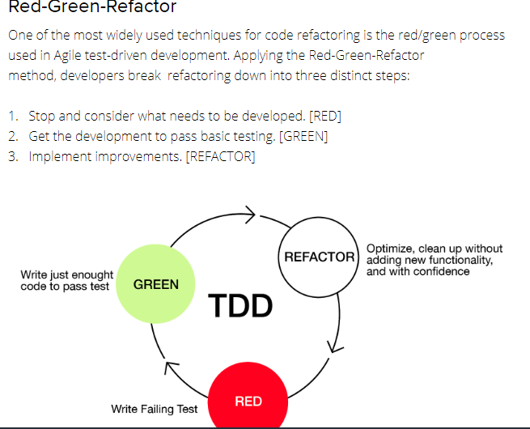

Slide 4
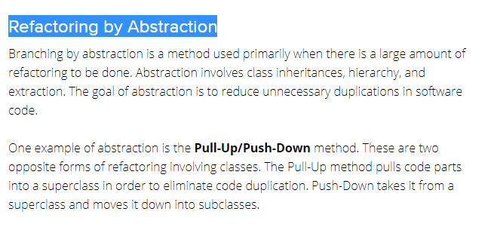

Slide 5
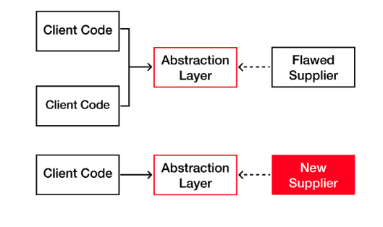

Slide 6
Composing Method
Composing involves streamlining the code in order to reduce duplications.
This is done through various processes, including extraction and inline methods.
Extraction involves breaking down the code into smaller chunks in order to find and “extract” fragmentation.
The fragmented code is then moved to a separate method and replaced with a call to this new method. In addition to the method, extraction can involve class, interface, and local variables as well.
Inline refactoring is a way to reduce the number of unnecessary methods while simplifying the code.
By finding all calls to the method and replacing them with the content of the method, the method can then be deleted.

Slide 7
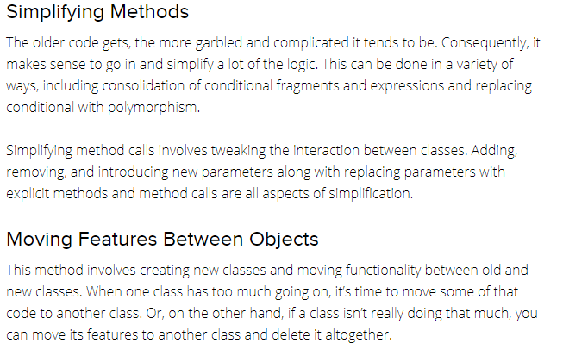

Slide 8
Preparatory Refactoring
This is done when a developer notices the need for refactoring while adding a new feature,
it’s actually a part of a software update as opposed to a separate refactoring process.
By noticing that the code needs to be updated at that moment, the developer is doing his or her part to reduce future technical debt.

Slide 9
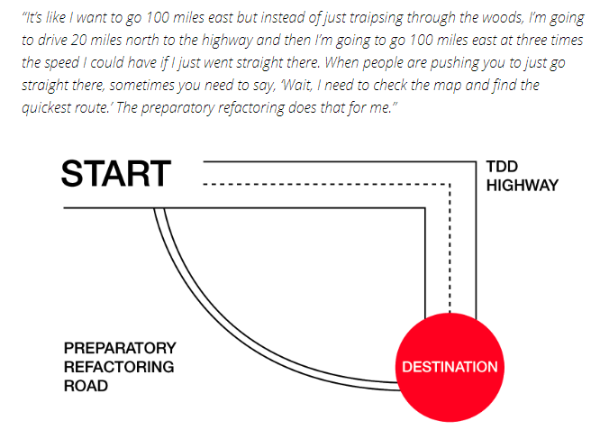

Slide 10
When you don’t need refactoring
There are times, however, when an application needs to be completely revamped from the start.
In these cases, refactoring is not necessary, as it would be much more efficient to simply start from scratch.
Another situation in which it would be wise to skip refactoring is if you are trying to get a product to market within a set time frame.
Refactoring can be like going down the proverbial rabbit hole: Once you start, it can become quite time-consuming.
Adding any additional coding or testing to an already tight timeline will lead to frustration and additional cost for your client.

Slide 11
Best practices for code refactoring
Refactor first before adding any new features
It is always a good idea to perform refactoring whenever you’re asked to add new features or updates to an existing solution.
Plan your refactoring project and timeline carefully
The most important outcome of refactoring is that not only is the code cleaner but that it actually works. And remember, it’s going to take longer than you think, so plan accordingly and give yourself a little extra cushion of time.
Test often
The last thing you want to do when refactoring is mess something up in the process and create bugs or problems that affect the functionality of the product. This is why testing throughout the refactoring process is imperative.

Slide 12
Get your QA team involved
It’s always a good idea to get your QA and testing team involved in the refactoring process. Whenever you’re making changes to existing code, even as a clean-up project, it can affect testing outcomes.
Focus on progress, not perfection
Try refactoring automation

